Slide 1
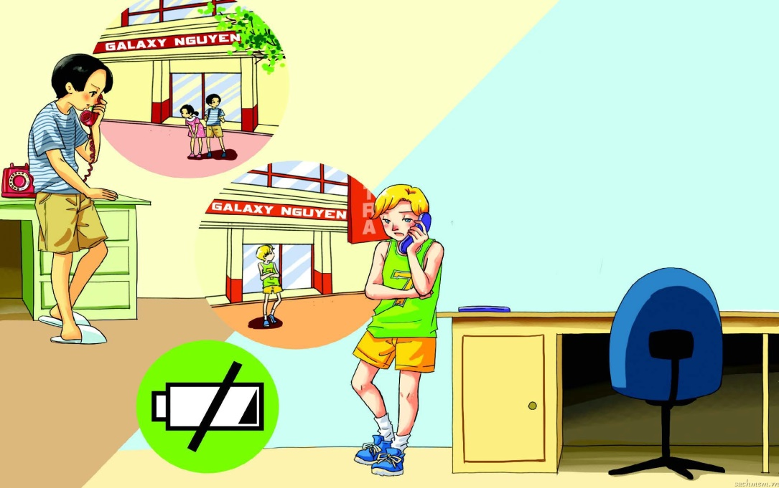
English 8
UNIT 10: COMMUNICATION
LESSON 7: LOOKING BACK AND PROJECT

Slide 2
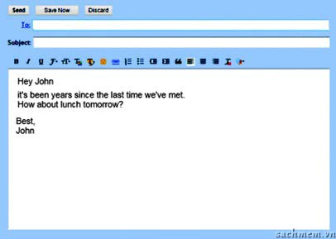
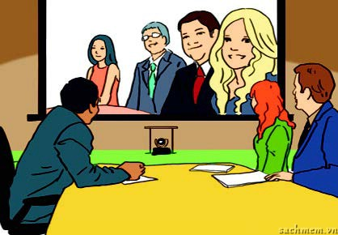
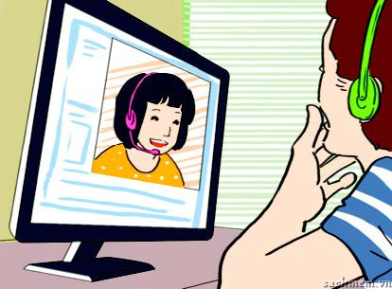
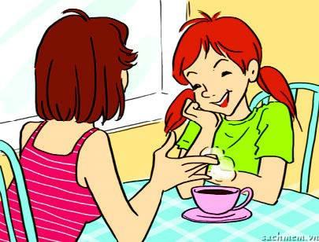
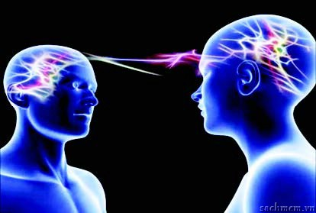
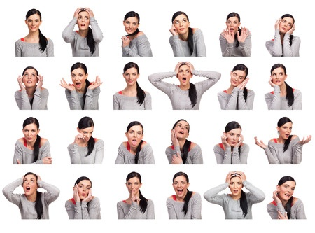
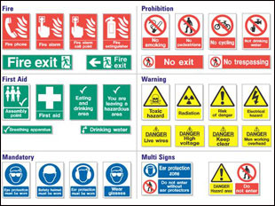
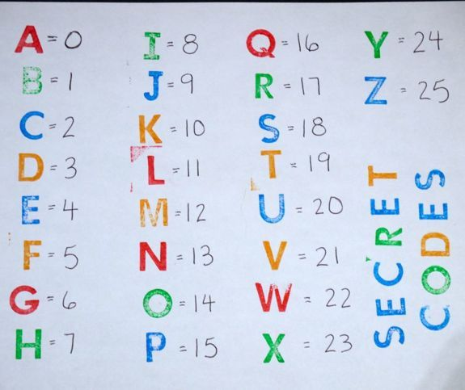
Warm up
having a video conference
video chatting
emailing
meeting face-to-face (F2F)
using social media
Ways of communication
using telepathy
using signs
sending letters (snail mail)
using body language
using codes

Slide 3
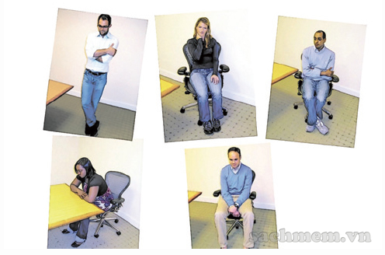
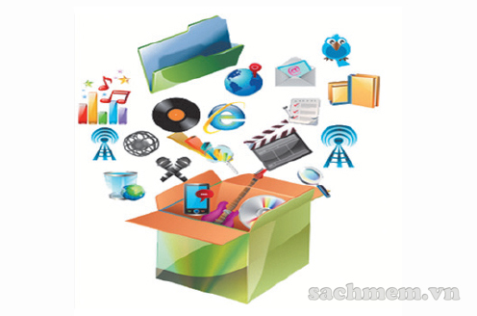
I. Vocabulary
Activity 1. Complete the sentences using the cues provided
anguage
Using b___ l________is an effective way for communication as long as you understand it.
M________ technology makes today’s communication so exciting with not only text but also sound, video, and graphics.
A lot of people prefer working f____________ than online.
ody
ultimedia
ace - to - face

Slide 4
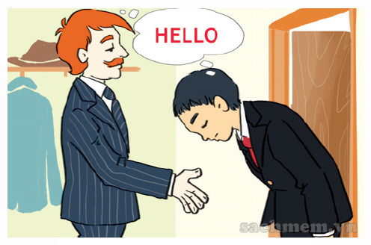
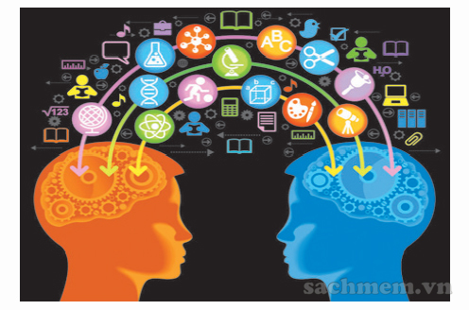
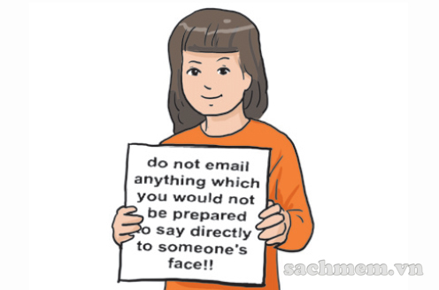
Communication breakdown may happen due to c______ d__________.
In the future we won’t need to learn different languages to communicate if we use t________.
Everyone needs to learn n________ when we communicate online.
ultural
ifferences
elepathy
etiquette

Slide 5
Activity 2. Write the following text messages/ chat lines in shorthand form.
Thanks for your gift.
By the way, what are you doing this weekend?
Please call me right now.
Laugh of loud.
See you tonight.
Thx 4 ur gift.
BTW, wot r u doin this wkd?
Pls call me rite now.
LOL!
C U 2nite.

Slide 6
Activity 3. Have you ever used music, art, codes, signs or any non-verbal way to communicate? Tell a partner what you did. Was the coomunication successful
Example:
I used music to express my love to my Mom.
The song is about the love of a daughter for her mother.
She was happy .

Slide 7
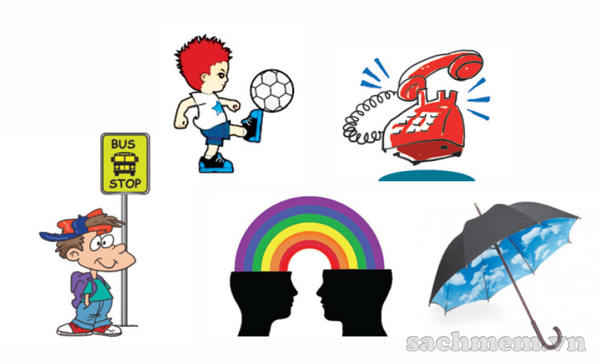
II. Grammar
Activity 4. Underline the correct answer.
She ( will not be sleeping / was not sleeping) if you call at 9 p.m.
They ( play/ will be playing) football at 10 a.m tomorrow.
What ( will he be doing/ will he do) this time next Monday?
I ( am waiting/ will be waiting) at the bus stop when you arrive.
In 200 years we ( will not be using/ do not use ) mobile phones any more. We ( will be using/ will use ) telepathy.
They’ve decided ( rains/ will be raining ) later today.

Slide 8
Activity 5. Gerund or to-infinitive?
talking
I don’t mind ( talk) _________ to her about this.
We plan (use) __________ video chatting to keep in touch with our family.
He’s tried very hard (show) ____________ his love to her by sending lots of flowers and presents.
She dislikes (communicate) ________________ through message boards or online meetings.
Lena enjoyed (chat) ____________ on the phone with her friends.
They’ve decided (have) ____________ a video conference with their colleagues right away.
to use
to show
communicating
chatting
to have

Slide 9
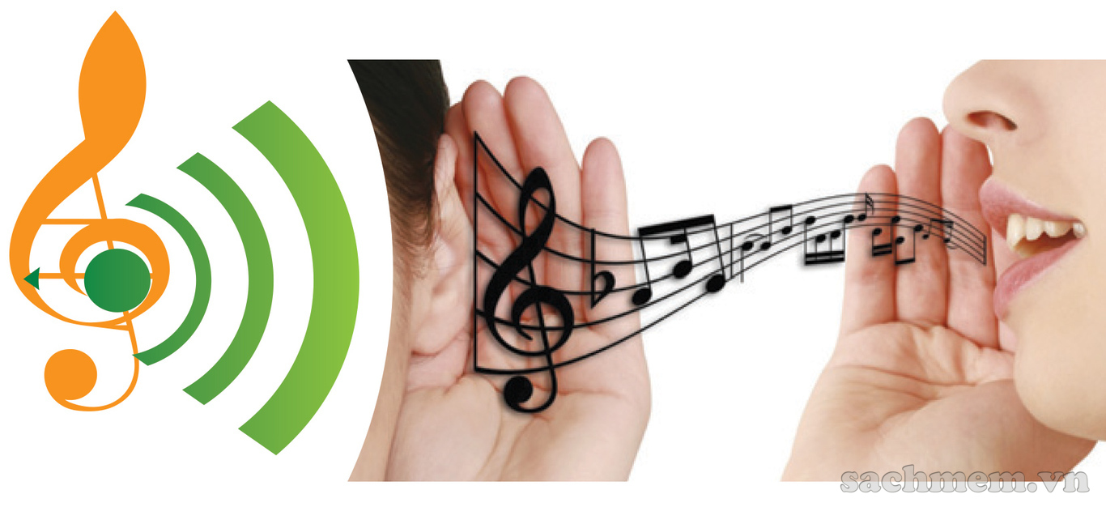
III. Communication
Activity 6. Choose any three form of communication in this unit and work with a partner to decide if people will be using them in year 2100 or not. Give at least two reasons for each decision
Example:
Will we be using music to communicate in the year 2100?
I think so. People will always express themselves through music.

Slide 10
IV. Project
In groups, prepare two versions of a short sketch involving a communication breakdown to perform in class.
Perform version 1 where the communication breakdown takes place.
Then ask the adience to explain what went wrong and how it could be avoided.
Next perform version 2, this time where no communication breakdown takes place.
You can ask yuor teacher for help with sketch ideas.

Slide 11
V. Homework
Prepare Unit 11 - Lesson 1: Getting started

Slide 12
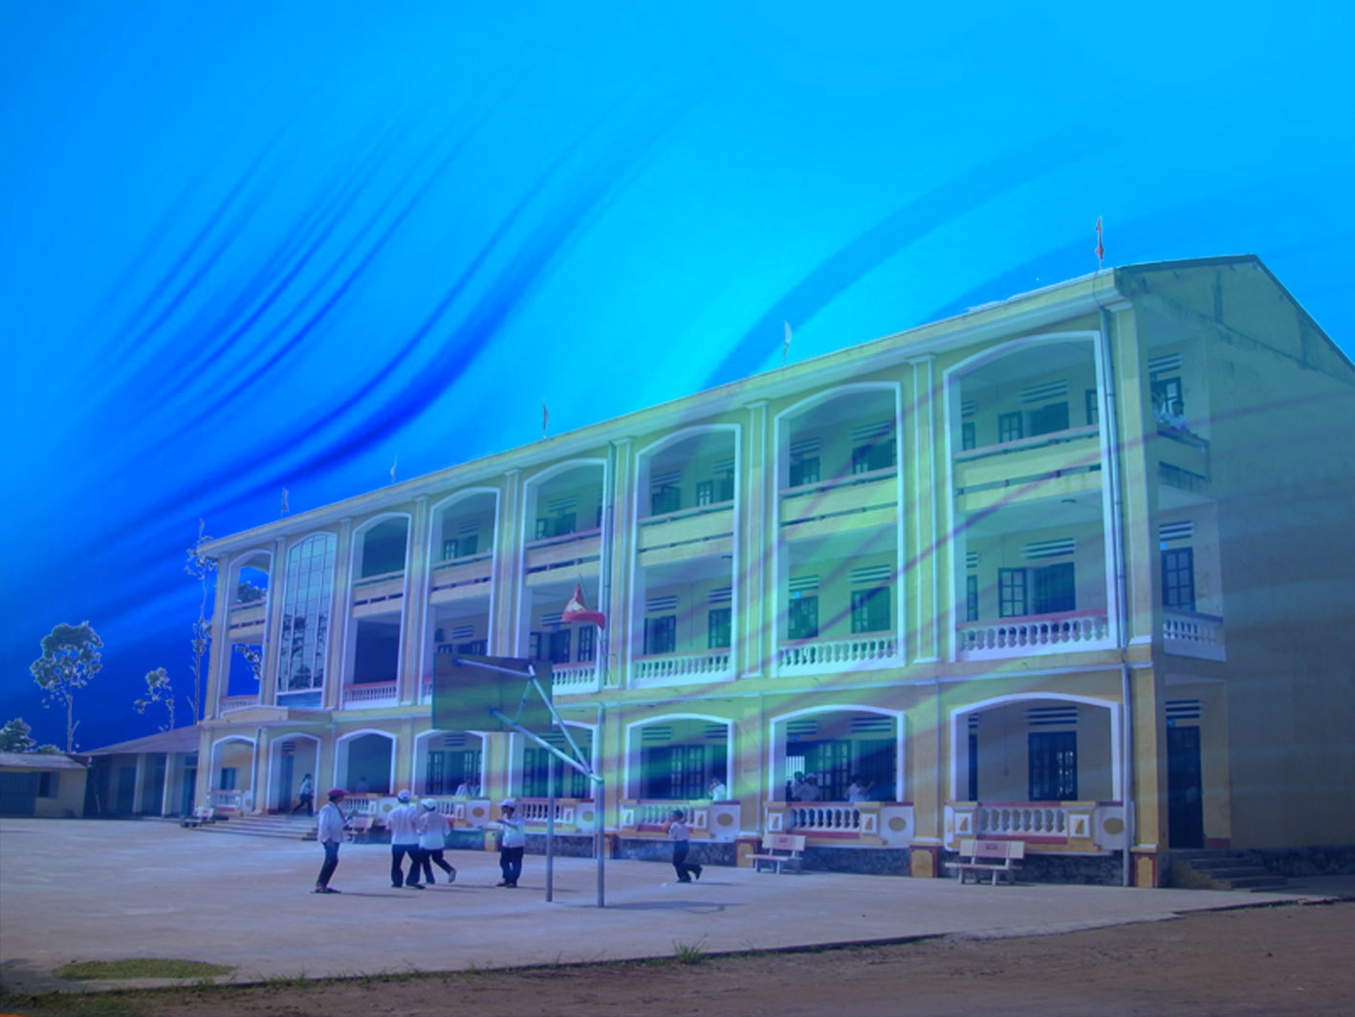
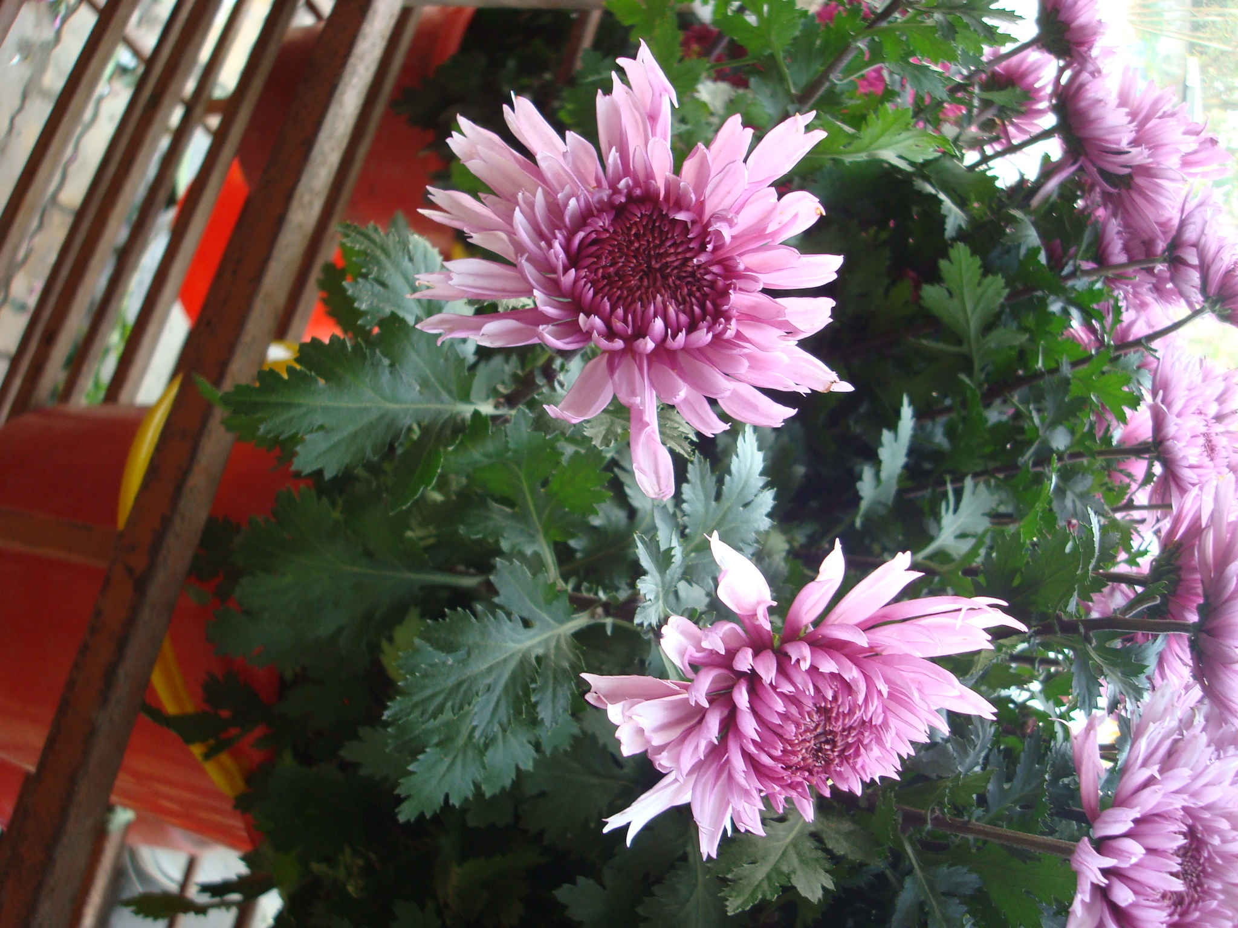
Thanks for your attendance
Goodbye

